Slide 1

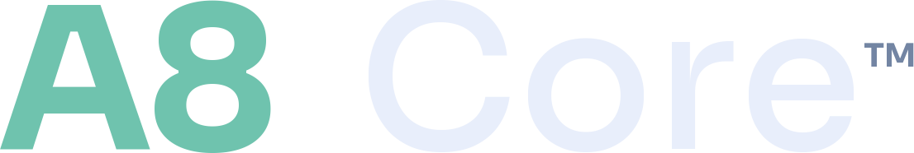
Brand Guide
The operating system for financial accounts.
Supersedes v2.0. Every colour, token and type value in this guide was read
out of the live site, not carried forward from the previous edition.
Version 3.0 · 2026 · Financial Infrastructure, Inc. · CONFIDENTIAL

Slide 2

HOW TO USE THIS GUIDE
Three rules, then the system.
This guide is the single source of truth for the A8 Core™ identity. Where an existing asset disagrees with it, the guide wins and the asset gets corrected.
1 · Ground truth beats memory
2 · Web and produced differ
3 · Claims carry evidence
Every hex value, token name and type face here was measured from the deployed stylesheet on the live site. If you need a value that is not in this guide, read it from the source — do not guess it from an older deck.
The live site is set in Sora, Inter and JetBrains Mono. Produced decks, PDFs and one-pagers are set in Arial. Both are correct; using the web faces in a deck is not, because the reader may not have them.
Structural facts (account types, natures, endpoints) are countable and may be stated. Performance, market and ROI figures may not be stated without a named, dated source. See Claims discipline.
What changed in v3.0 is recorded in full on the Drift register at the back of this guide — including two errors carried by v2.0.
A8 Core™ Brand Guide · v3.1 · 2026 · Financial Infrastructure, Inc. · Published for press & partner use
2

Slide 3

01
Brand
Who we are, what we are called, and the sentence everything else has to agree with.
A8 Core™ Brand Guide · v3.1 · 2026 · Financial Infrastructure, Inc. · Published for press & partner use
3

Slide 4
BRAND AT A GLANCE
What A8 Core™ is — and how we say it.
The one-liner
A8 Core™ is the API-driven, bank-grade account core that fintech and wealthtech build on — opening, funding and transacting across every account type on one multi-tenant, white-label integration.
The category
The wedge
The operating system for financial accounts — the account core that spans banking AND wealth.
Cores are siloed by lane. A8 Core™ is one core across DDA, retirement, taxable, trust and private-fund.
The moat
The security position
Full-spectrum coverage, multi-tenant and white-label delivery, structural switching costs, clean registered IP.
Secured by B5 Secure™ — a named component, not a claim A8 Core™ makes about itself.
A8 Core™ Brand Guide · v3.1 · 2026 · Financial Infrastructure, Inc. · Published for press & partner use
4

Slide 5
NAME, ENTITY AND MARKS
Get the name right first.
The product name, the operating entity and the IP holder are three different things and are not interchangeable in copy.
Product name
A8 Core™ — always two words, capital A, capital C, ™ on first prominent use per asset
Never written
A8core · A8-Core · a8core (except in a URL or code identifier) · A8 CORE in running copy
Operating entity
Financial Infrastructure, Inc. (Delaware)
IP holder
Todd Yancey — A8 Core™ and related IP remain solely with Todd Yancey
Copyright line
© Copyright 2015–2026 Todd Yancey. A8 Core™ and related IP remain solely with Todd Yancey.
Press contact
press@a8core.com
Sales contact
sales@a8core.com — the published address on /contact/
Retired predecessor platform name (pre-2026). It must not appear in any new asset. Historic files under /uploads/media/ keep their legacy names on purpose and are retained, not republished.
A8 Core™ Brand Guide · v3.1 · 2026 · Financial Infrastructure, Inc. · Published for press & partner use
5

Slide 6
THE STACK
One stack, four layers.
This is the sentence that closes every page on the site. It is the canonical description of how the four brands relate, and it is the wording to reuse.
1
2
3
4
InvestNow
A8 Core™
Investor Services
B5 Secure™
Find it on
clears and settles it
custodies it
authorizes every data element
The retail discovery surface.
The account operating system.
The custodian of record.
The enforcement layer.
“One stack, four layers. Find it on InvestNow. A8 Core™ clears and settles it. Investor Services custodies it. B5 Secure™ authorizes every data element.”
A8 Core™ Brand Guide · v3.1 · 2026 · Financial Infrastructure, Inc. · Published for press & partner use
6

Slide 7
02
Logo
The lockup, the space around it, and the six things that break it.
A8 Core™ Brand Guide · v3.1 · 2026 · Financial Infrastructure, Inc. · Published for press & partner use
7

Slide 8
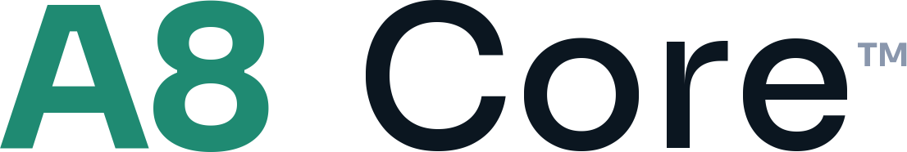
THE LOCKUP
Two runs, one baseline.
The lockup is pure type set in Sora — “A8” in verdigris at weight 800, “Core” in near-white at weight 500, and the ™ at 0.30em. There is no plate: an earlier mark had one and it is retired.
Reverse — default, on ledger ground
Positive — light backgrounds only
Clear space
Exact values
Home position
Keep clear space on all four sides equal to the cap height of the “A”. Never crowd it.
A8 #6FC3AE at weight 800. Core #E8EEFB at weight 500, offset 0.40em. ™ at 0.30em, #7385A3.
Top-left on decks, documents and diagrams. It is the same position on every asset.
A8 Core™ Brand Guide · v3.1 · 2026 · Financial Infrastructure, Inc. · Published for press & partner use
8

Slide 9
LOGO — DON’T
Protect the mark.
Six failure modes. Each one is a rejection, not a preference.
✗
Don’t stretch, condense or distort
✗
Don’t recolour outside the palette
Scale proportionally, always.
White, ink, or a single verdigris tone.
✗
Don’t add shadows, glows or outlines
✗
Don’t place reverse on a busy ground
The mark carries no effects.
Contrast must reach 4.5:1 behind the mark.
✗
Don’t rotate or rearrange
✗
Don’t re-typeset the wordmark
Mark left, wordmark right, level.
It is artwork, not live text.
A8 Core™ Brand Guide · v3.1 · 2026 · Financial Infrastructure, Inc. · Published for press & partner use
9

Slide 10
03
Colour
A dark ledger ground, one verdigris accent ramp, and a legacy token name that lies.
A8 Core™ Brand Guide · v3.1 · 2026 · Financial Infrastructure, Inc. · Published for press & partner use
10

Slide 11
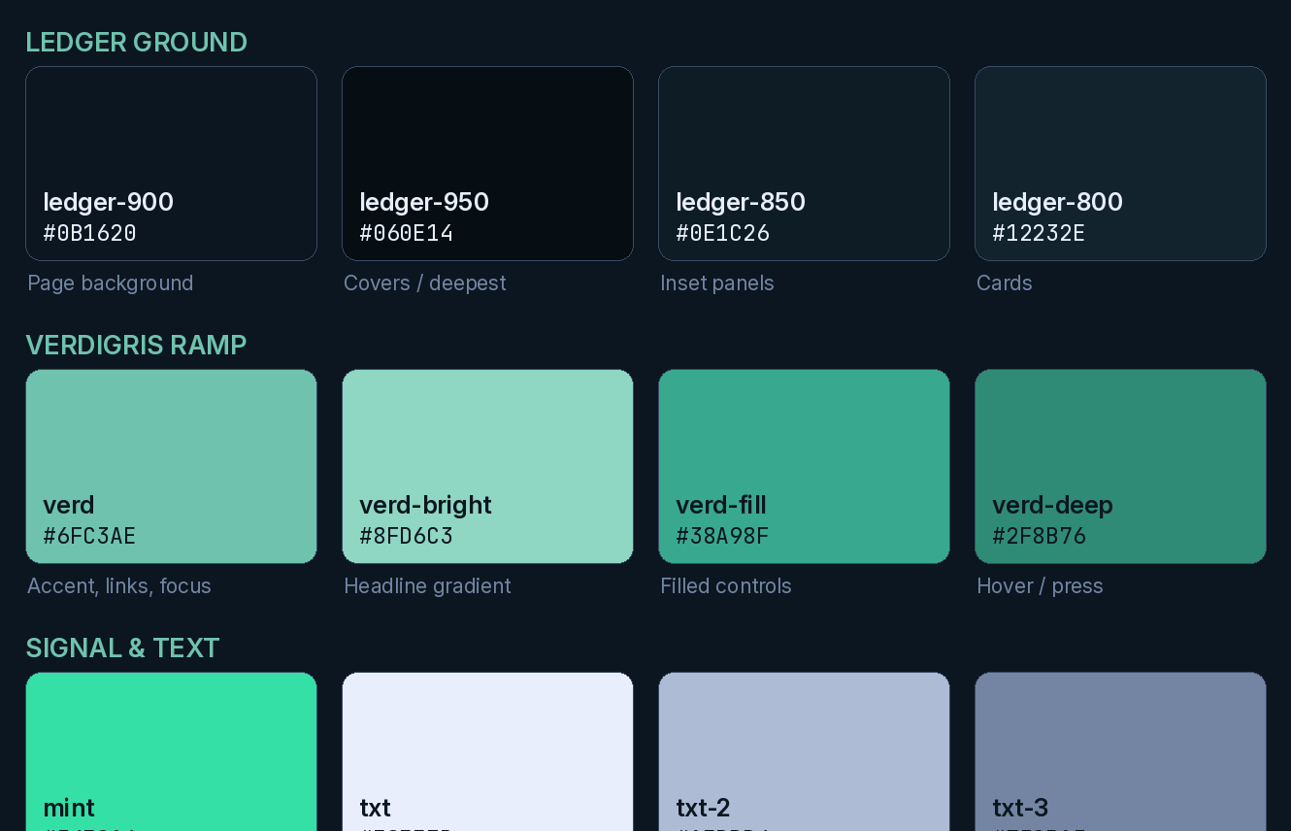
THE PALETTE
Ledger ground, verdigris accent.
Deep ledger navy is the foundation and carries roughly 70% of the visual weight. Verdigris is the single accent ramp. Mint is the positive highlight, used sparingly.
HOW TO USE IT
Weight it, don’t balance it
Ledger ground carries about 70% of the visual weight, verdigris 20%, mint and amber the last 10%. Equal weighting is the fastest way to look off-brand.
One accent ramp, not two
Verdigris is the only accent family. There is no secondary brand hue.
Status colour is semantic
Mint, amber and rose signal state. They are never decorative.
Where these values came from
Read from uploads/a8core.css on the deployed site — not carried forward from v2.0.
A8 Core™ Brand Guide · v3.1 · 2026 · Financial Infrastructure, Inc. · Published for press & partner use
11

Slide 12
COLOUR — A TRAP IN THE TOKEN NAMES
The tokens called “blue” are verdigris.
A8 Core™ inherited its first stylesheet from B5 Secure™, whose accent is blue. The palette was migrated to verdigris; the token names were not. Both names still resolve, to the same value.
--blue: #6FC3AE --verd: #6FC3AE /* identical */
--blue-bright: #8FD6C3 --verd-bright: #8FD6C3 /* identical */
--blue-deep: #2F8B76 --verd-deep: #2F8B76 /* identical */
What this means for you
What to write in new CSS
Never describe the A8 Core™ accent as blue. It is verdigris. Any copy, deck or note that says “electric blue” is describing the retired palette — v2.0 of this guide did exactly that on two pages.
Use the --verd* names. The --blue* names are retained aliases so existing rules keep working; they are not deprecated in code, but they are deprecated in language.
A8 Core™ Brand Guide · v3.1 · 2026 · Financial Infrastructure, Inc. · Published for press & partner use
12

Slide 13
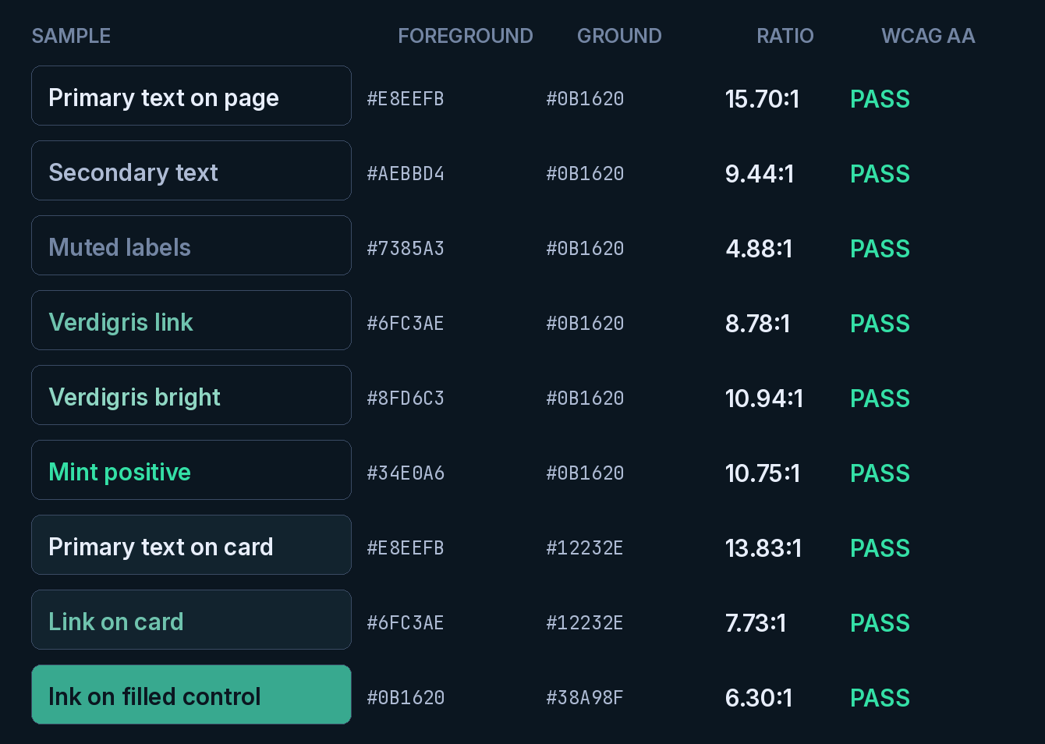
COLOUR — ACCESSIBILITY
Measured, not assumed.
Every pairing below was computed against the WCAG 2.1 relative-luminance formula. Any new pairing must be measured the same way before it ships.
THE RULES
4.5:1 is the floor
Body text and anything below 24px bold needs 4.5:1 against the colour actually behind it. Display text may sit at 3:1, but on this ground it never has to.
Measure the composited pixel
Cards, washes and gradients change what is behind the text. Sample the rendered pixel, not the token you intended.
Never sample inside a glyph
It returns exactly 1.00:1, because the text is being compared with itself. Snapshot the ground before the text is drawn.
Colour is never the only channel
Status must also carry a word or a glyph.
A8 Core™ Brand Guide · v3.1 · 2026 · Financial Infrastructure, Inc. · Published for press & partner use
13

Slide 14
04
Typography
Two type systems, one for the browser and one for everything you hand someone.
A8 Core™ Brand Guide · v3.1 · 2026 · Financial Infrastructure, Inc. · Published for press & partner use
14

Slide 15
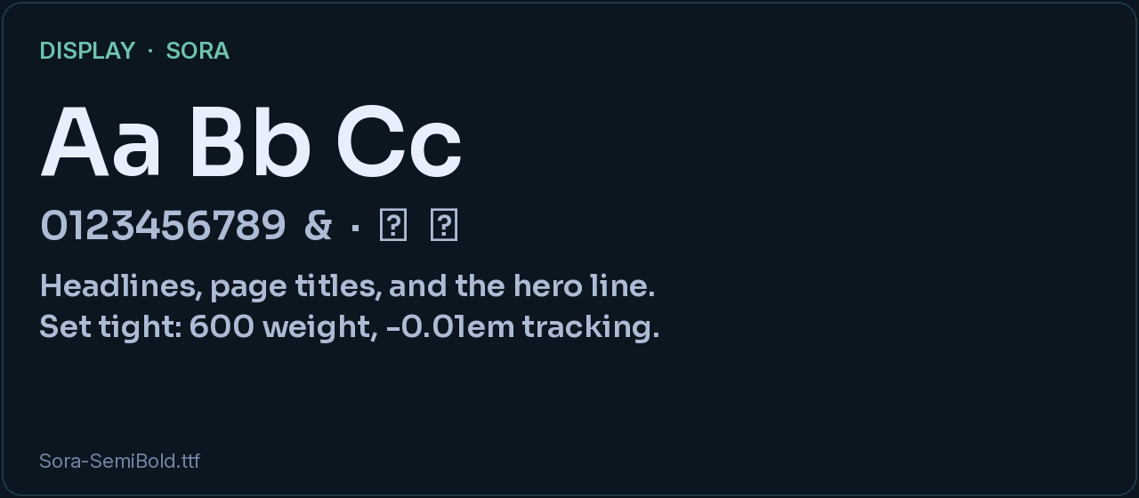
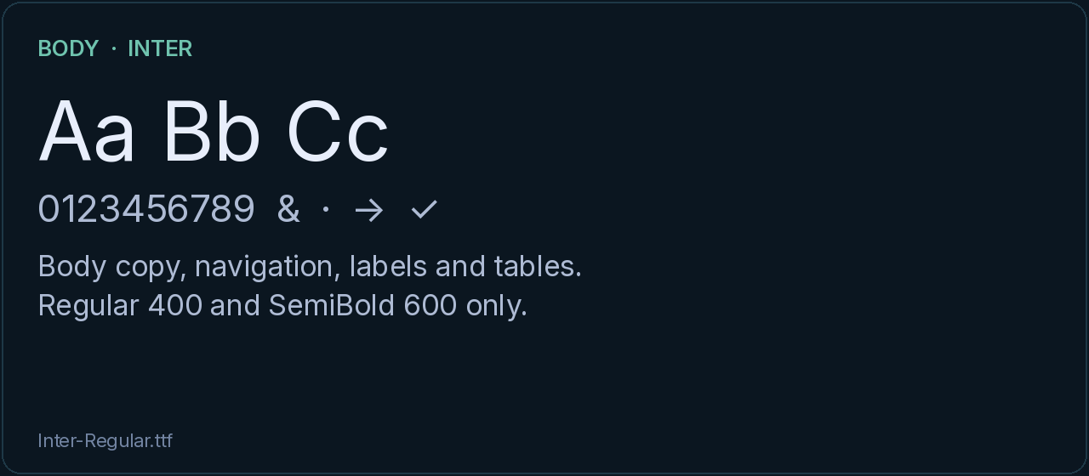
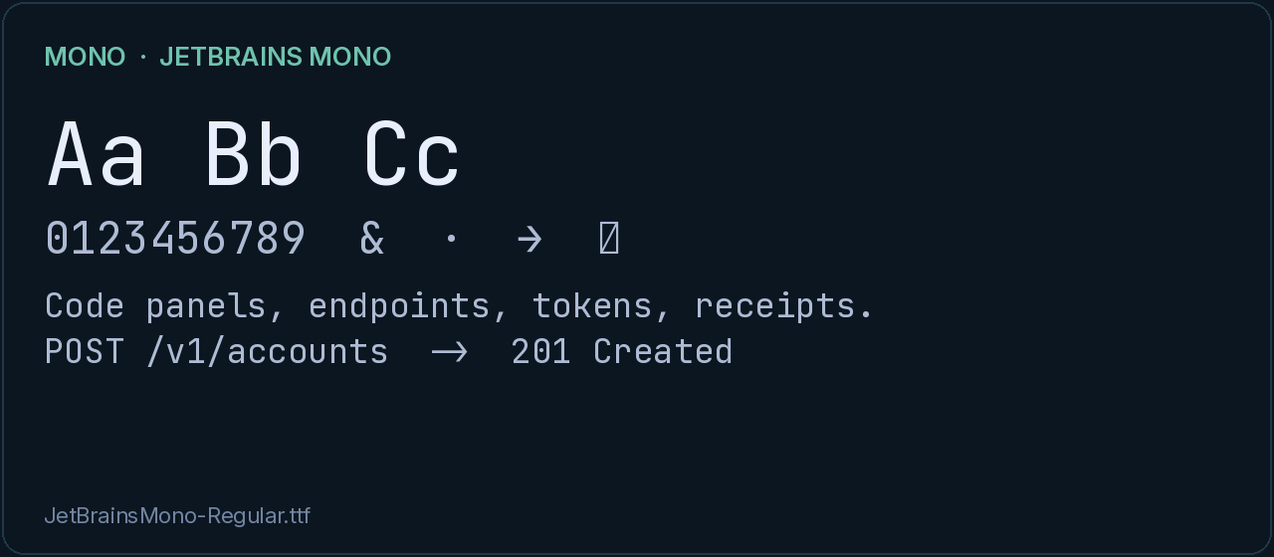
TYPE — THE WEB SYSTEM
Sora, Inter, JetBrains Mono.
All three are self-hosted on the site. They are the correct faces for anything rendered in a browser.
Display — Sora
600 weight, tracking −0.01em. Page titles, hero lines, card headings.
Body — Inter
400 and 600 only. Body copy, navigation, labels, tables.
Mono — JetBrains Mono
400 and 700. Code panels, endpoints, tokens, receipts.
A8 Core™ Brand Guide · v3.1 · 2026 · Financial Infrastructure, Inc. · Published for press & partner use
15

Slide 16
TYPE — PRODUCED ASSETS
Arial, and why.
A deck or PDF is opened on a machine you do not control. Sora and Inter are not installed there, so the reader gets a substitute with different widths and your layout breaks. Produced assets are therefore set in Arial.
Display
Arial Bold, 32–44pt
Aa Bb Cc
Section header
Arial Bold, 20–24pt
Body
Arial Regular, 11–14pt
0123456789
Eyebrow
Arial Bold, uppercase, +2.4 tracking, verdigris
The quick brown fox jumps over the lazy dog.
Mono
Courier New — the safe mono across Office
SECTION LABEL
Caption
Arial Regular, 10pt, txt-3
Arial — display, body and eyebrow in produced assets
One exception: a type specimen may show the web faces, because there it is the subject rather than the vehicle. Render it as an image, as the previous page does.
A8 Core™ Brand Guide · v3.1 · 2026 · Financial Infrastructure, Inc. · Published for press & partner use
16

Slide 17
05
Components
The parts the site is actually assembled from.
A8 Core™ Brand Guide · v3.1 · 2026 · Financial Infrastructure, Inc. · Published for press & partner use
17

Slide 18
COMPONENTS
Cards, chips, panels, tables.
These class families already exist in a8core.css. Before authoring a new component, look for the family that covers it — there usually is one.
Card — .fx-card
Code panel — .console
Rounded rectangle, ledger-800 fill, 1px line border. The base container for everything. Full borders only; never a single-side accent stripe.
.console with .console-bar, .console-title and .console-body. Token classes .c-verb .c-path .c-str .c-key .c-num .c-ok .c-com .c-event .c-mut.
Figure block — .fx-*
Form field — .field
Fifteen members: fx-card, fx-grid, fx-table, fx-flow, fx-steps, fx-calc, fx-status, fx-chip, fx-note, fx-out, fx-res, fx-dep, fx-tool, fx-q, fx-2.
Includes .field select. Native <option> lists are painted by the OS, so both the select and its option must be set explicitly or the popup is unreadable.
The honeypot class .hp-field is defined and render-verified off-screen. Use it; do not invent a new hidden field.
A8 Core™ Brand Guide · v3.1 · 2026 · Financial Infrastructure, Inc. · Published for press & partner use
18

Slide 19
STATUS VOCABULARY
A badge is a claim. Spell it one way.
Status chips tell a buyer what is real today. The label set is closed, and the casing is part of the label.
Product specification
Design partner
In progress
Roadmap
Foundation
Provider dependent
Two CSS states exist: .fx-chip.st-dp (design partner) and .fx-chip.st-ip (in progress). Everything else inherits the base chip.
OPEN DEFECT · CASE DRIFT
"Design partner" 4 pages "design partner" 5 pages
"In progress" 8 pages "in progress" 1 page
Recommendation: normalise to sentence case — Design partner, In progress — in the next content pass. Ten edits.
A8 Core™ Brand Guide · v3.1 · 2026 · Financial Infrastructure, Inc. · Published for press & partner use
19

Slide 20
06
Voice
How A8 Core™ sounds, and the sentences it does not say.
A8 Core™ Brand Guide · v3.1 · 2026 · Financial Infrastructure, Inc. · Published for press & partner use
20

Slide 21
VOICE AND TONE
Confident, precise, builder-to-builder.
We lead with the customer’s problem — build versus buy — name the category, and quantify honestly. No hype, no hedging.
Confident
Precise
Honest
Concrete
We state. We do not hedge. Declarative sentences, answer first.
Exact terms. Authentication is not authorization. Signing is not encryption.
Name the limit. Mark modelled figures as modelled. Cite the source.
Countable nouns and named mechanisms beat adjectives every time.
“One core, every account type, one integration. A8 Core™ is the operating system for financial accounts — and B5 Secure™ authorizes every data element.”
A8 Core™ Brand Guide · v3.1 · 2026 · Financial Infrastructure, Inc. · Published for press & partner use
21

Slide 22
MESSAGING
Say this. Not that.
WE SAY
WE AVOID
The operating system for financial accounts
One core, every account type, one integration
Spans banking and wealth
Secured by B5 Secure™
Compliance and reporting are a native feature
Structural figures, each traceable to the catalog
“The audit record is the product”
“Compliance is the moat”
SR 26-2 / fair-lending / UDAAP framing
“Full core-banking replacement”
Hype, superlatives and vague claims
Any market or ROI number without a named, dated source
A8 Core™ Brand Guide · v3.1 · 2026 · Financial Infrastructure, Inc. · Published for press & partner use
22

Slide 23
POSITIONING GUARDRAILS
The non-negotiables.
Every asset — deck, document, diagram, page — must hold these four. They are what keeps the category clear.
✓
A8 Core™ is the account operating system
✓
Compliance and reporting are native features
Spanning the full account spectrum. Not single-lane, not a thin wrapper, not a full core-banking replacement.
Controls plus 1099/5498-style reporting per account type and transaction — never “compliance as the product”.
✓
Security is “secured by B5 Secure™”
✓
Lineage is pedigree only
A named component: fail-closed authorization, signed requests, evidence. Do not import B5’s GTM or scale claims into A8 copy.
ICP → ISCP → A8 Core™. ICP is the owner’s registered work; full rights retained. It is not a customer logo wall.
A8 Core™ Brand Guide · v3.1 · 2026 · Financial Infrastructure, Inc. · Published for press & partner use
23

Slide 24
CLAIMS DISCIPLINE
What may be stated, and on whose authority.
The site publishes structural facts about a catalog. That is defensible. Anything else needs a source or an owner attestation.
STATEABLE — STRUCTURAL AND COUNTABLE
NOT STATEABLE WITHOUT A SOURCE
45
Account types defined
Market size, growth rate, or share
ROI, cost saving, or time-to-market for a customer
Uptime, latency or throughput without a measurement window
Any comparison to a named competitor’s capability
Customer names, logos or counts before consent is on file
Regulatory status, approval, or charter language
43
Account types enabled (2 defined, not enabled)
5
Account natures
10
Asset classes modelled
39
Contribution-limit figures, cited to IRS releases
Each of these is a count over a published catalog. State the figure and the date, and say “structural, not a performance claim” where it could be misread.
A dated “last updated” line on a legal page is itself a factual claim. Re-dating a document you did not revise is a false statement — leave it.
A8 Core™ Brand Guide · v3.1 · 2026 · Financial Infrastructure, Inc. · Published for press & partner use
24

Slide 25
07
Assets
Where everything lives, and what is new in this edition.
A8 Core™ Brand Guide · v3.1 · 2026 · Financial Infrastructure, Inc. · Published for press & partner use
25

Slide 26
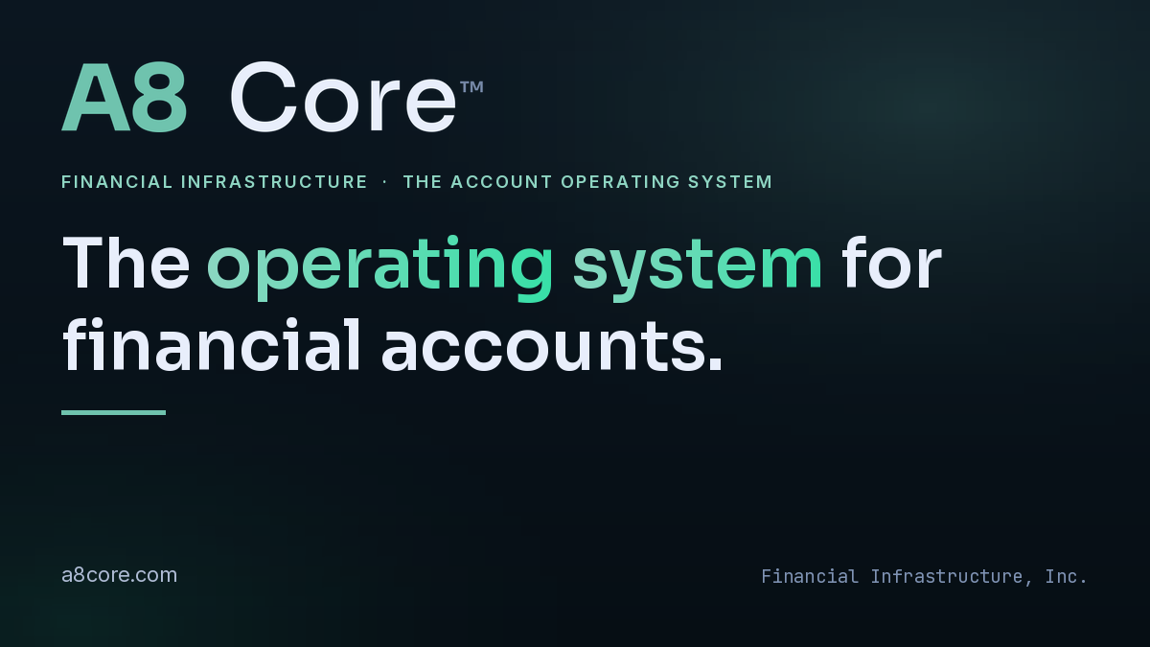
SOCIAL AND OPENGRAPH
The share card is a brand surface.
A link posted to LinkedIn or X renders the OpenGraph card, not the page. It is often the first brand impression a buyer gets.
New default
a8core-og-1200x675.png
Size
1200 × 675 px (16:9)
Set in
Yoast SEO → Social → Default image
Ground
ledger-900 to ledger-950
Type
Sora SemiBold + gradient run
Safe area
64px on all four edges
Also available
1200×630, 1584×396, 1500×500
1200 × 675 is 16:9, which X and LinkedIn prefer. Facebook’s canonical ratio is 1.91:1, so it may trim a few pixels top and bottom — which is why nothing sits within 64px of an edge.
A8 Core™ Brand Guide · v3.1 · 2026 · Financial Infrastructure, Inc. · Published for press & partner use
26

Slide 27
ASSET INDEX
Everything, with its real path.
All paths are relative to https://a8core.com/wp-content/. Verified present in the deployed site.
BRAND AND MEDIA
DIAGRAMS, CSS AND CHROME
uploads/media/
a8core-lockup-white.png reverse lockup
a8core-lockup-ink.png positive lockup
a8core-wordmark-white.png wordmark only
a8core-wordmark-ink.png wordmark only
a8core-og-1200x675.png OG default (new)
og-card-1200x630.png legacy OG card
linkedin-banner-1584x396.png
x-header-1500x500.png
A8-Core-Brand-Guide-v3.pdf this document (new)
A8-Core-Brand-Guide.pdf v2.0, retained
A8-Core-Media-Kit.pdf
uploads/media/
01-where-a8core-fits.svg / .png
02-account-spectrum.svg / .png
03-architecture.svg / .png
uploads/
a8core.css tokens + components
a8core-base.css base layer
a8core-docs.css documentation pages
a8core-nav.html live header (edit here)
a8core-footer.html live footer (edit here)
og/*.png 176 per-page OG cards
The header and footer are HTML files rendered by a mu-plugin, not theme templates or a menu. Editing the theme does nothing.
A8 Core™ Brand Guide · v3.1 · 2026 · Financial Infrastructure, Inc. · Published for press & partner use
27

Slide 28
DRIFT REGISTER
What v2.0 got wrong, and what is still open.
A brand guide that hides its own errors cannot be trusted as a source. These were found by measuring the live site against the previous edition.
CORRECTED IN v3.0
“Electric blue is the primary accent”
Wrong on two pages of v2.0. The accent is verdigris #6FC3AE. The --blue* tokens are aliases of it.
ledger-850 = #12232E
Wrong. The live value is #0E1C26. #12232E is ledger-800.
OPEN — NEEDS AN OWNER DECISION, NOT A DESIGN DECISION
“per-record” on 16 pages
20 instances, 6 on legal pages, while 133 pages say “data element”.
Status label casing
“design partner” vs “Design partner”; “In progress” vs “in progress”.
A8 Core™ Brand Guide · v3.1 · 2026 · Financial Infrastructure, Inc. · Published for press & partner use
28

Slide 29
QUICK REFERENCE
One page to keep open.
COLOUR TOKENS
TYPE
THE FOUR THINGS
ledger-900 #0B1620
ledger-950 #060E14
ledger-850 #0E1C26
ledger-800 #12232E
line #1E3846
verd #6FC3AE
verd-bright #8FD6C3
verd-fill #38A98F
verd-deep #2F8B76
mint #34E0A6
txt #E8EEFB
txt-2 #AEBBD4
txt-3 #7385A3
Web display: Sora 600
Web body: Inter 400 / 600
Web mono: JetBrains Mono
Produced: Arial (Courier New for mono)
Eyebrow: bold, uppercase, +2.4 tracking, verdigris
Home position: top-left, every asset
The accent is verdigris, never blue
Reverse logo is the default; dark ground
Structural counts may be stated; ROI may not
Secured by B5 Secure™ — a component, not a claim about A8
A8 Core™ Brand Guide · v3.1 · 2026 · Financial Infrastructure, Inc. · Published for press & partner use
29

Slide 30
The operating system for financial accounts.
Questions, or a new asset to review: press@a8core.com
© Copyright 2015–2026 Todd Yancey. A8 Core™ and related IP remain solely with Todd Yancey.
A8 Core™ is a trademark used by Financial Infrastructure, Inc. (Delaware). Published for press & partner use.

